Slide 1
Mobile and Distributed Computing(System)
FUNDAMENTALS OF DISTRIBUTED COMPUTING
Definition of Distributed Computing (systems) (DS)
1- DS is a system which components are located at the networked computer communication and coordinate their activities (actions) by only messages.
2- A distributed System or computing is a collection of autonomous or independent computers linked by a computer network and equipped with distributed system software (S/W) (middleware).

Slide 2
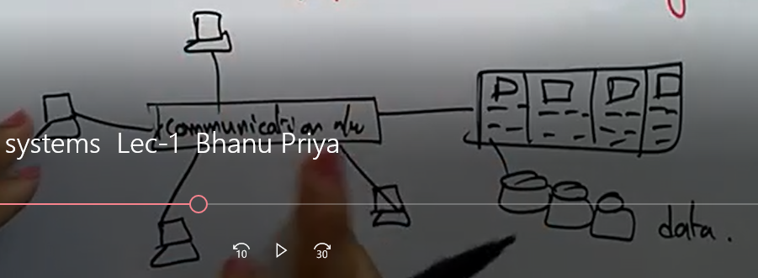
Block Diagram of a Distributed System

Slide 3
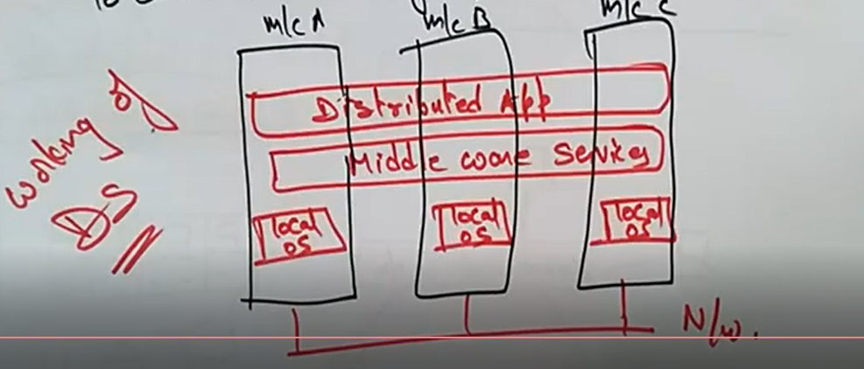
Distributed System Software(S/W)
The role of the DS s/w is to coordinate the activities of the various computers and enable them to share their resources ( hardware, software, and data)

Slide 4
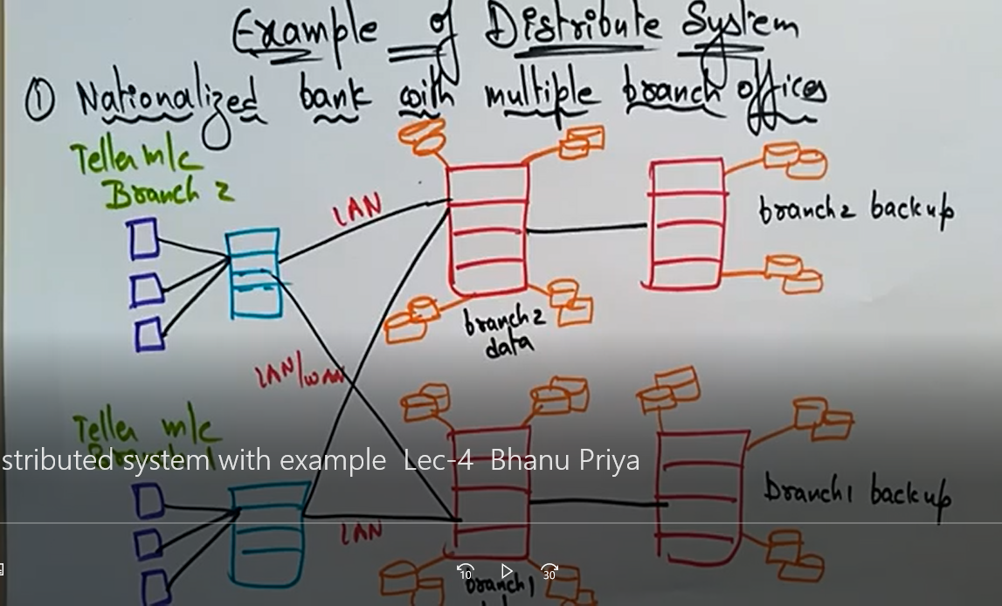
Distributed Systems Application and Examples

Slide 5
Requirements of a Distributed system
1- Security and Reliability
2- Consistency of replicated data
3- Concurrent transaction
4- Fault Tolerance

Slide 6
Applications
1- Finance and Commerce:
eg e-commerce, amazon, e-bay, online banking etc.
2- Information Society :
Eg : search engines, Wikipedia , social networking (Facebook, twitter , WhatsApp etc)
3- Creative Industries and Entertainment :
Eg online gamming , music, YouTube channelling
4- Education : eg e-learling , distance learning

Slide 7
Applications of Ds
5- Health Care : eg online patient record, health informatics
6- Transport and Logistics : Gps, google maps
7- Science for collaboration
8- Environment management: sensor technology.

Slide 8
CHARACTERISTICS OF DS OR CHALLENGES OF DS
1- Resource sharing : - it is the ability to use any hardware , software or data anywhere in the system ( different computers, different configuration)
2- Openness : it is concerned with extension and improvement of the system of DS
3- Concurrency : separate activities of users independent the resources and the location of the server processes e.g. I can do my work my computer while you do your work on yours sharing resources(webpages or files)

Slide 9
4- Scalability: how to increase the scale of the system (accommodating more users to explore the corresponding response of the system).
5- Faults Tolerance : this cares about the reliability of the system ( any case of a failure of a hardware or the software the system should continue to work properly without significantly degrade the performance of the system.) There can be fault in the Network(isolation: system becoming slow); unexpected termination of a program(crash).
6- Transparency : this hides the complexity of a distributed system to the end users and application programs.

Slide 10
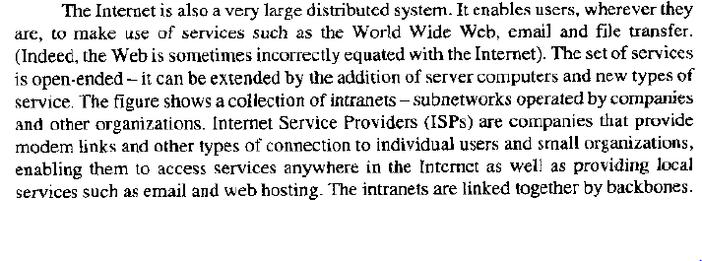
Examples of Ds
1- the internet

Slide 11
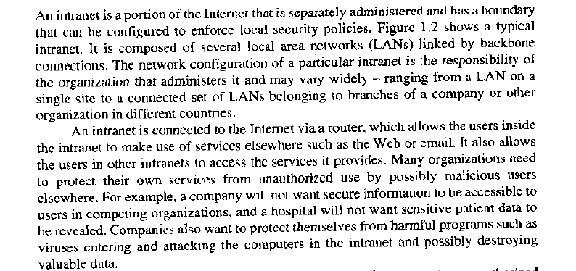
2- the intranet

Slide 12
MOBILE AND UBIQUITOUS COMPUTING
Ubiquitous computing (or "ubicomp") is a concept in software engineering and computer science where computing is made to appear anytime and everywhere. In contrast to desktop computing, ubiquitous computing can occur using any device, in any location, and in any format.

Slide 13
MOBILE COMPUTING
Mobile computing also known as nomadic computing is the performance of computing tasks when the user is on the move or visiting places other than their usual environment.

Slide 14
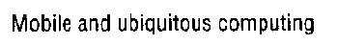
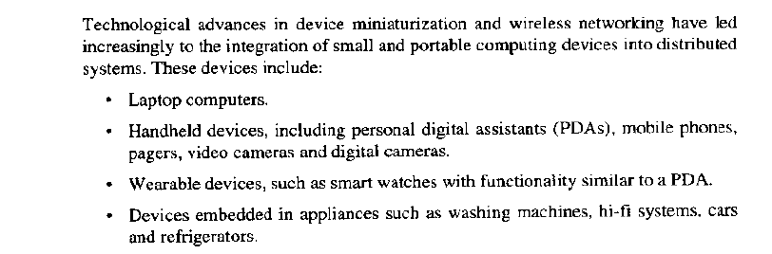
Mobile and Ubiquitous Computing

Slide 15
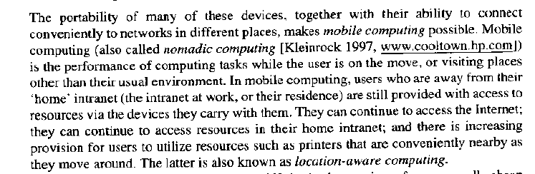

Slide 16
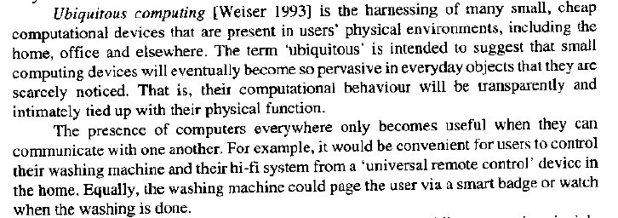

Slide 17
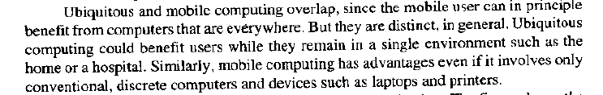
Cont….

Slide 18
Advantages of D.S
It inherently distributed applications
Information sharing is among users is geographically distributed
Resource sharing
Better price performance ratio
Shorter respond time and higher throughput
Higher reliability and availability of component failure
Extensibility and incremental growth
Better flexibility

Slide 19
Disadvantages of D.S
Relevant software does not exist currently
Security issues due to easy access to all data ( despite of authentication or cryptographic techniques used)
Networking saturation may cause hurdle in data transfer (cause problem accessing the data or the internet)

Slide 20
Factors (issues) to consider when designing D.Ss
1- Transparency ( hide important applications
2- Flexibility
3- Reliability (technology)
4- Performance
5- Scalability
6- Security

Slide 21
Architecture of DS
We have two types of DS Architecture :
- Shared Memory Architecture
- Distributed Memory Architecture
Shared memory Architecture is a tightly coupled system while the distributed memory architecture is loosely coupled system.
The shared memory is easier to program but the distributed memory architecture offers a superior price ratio thus scalability.

Slide 22
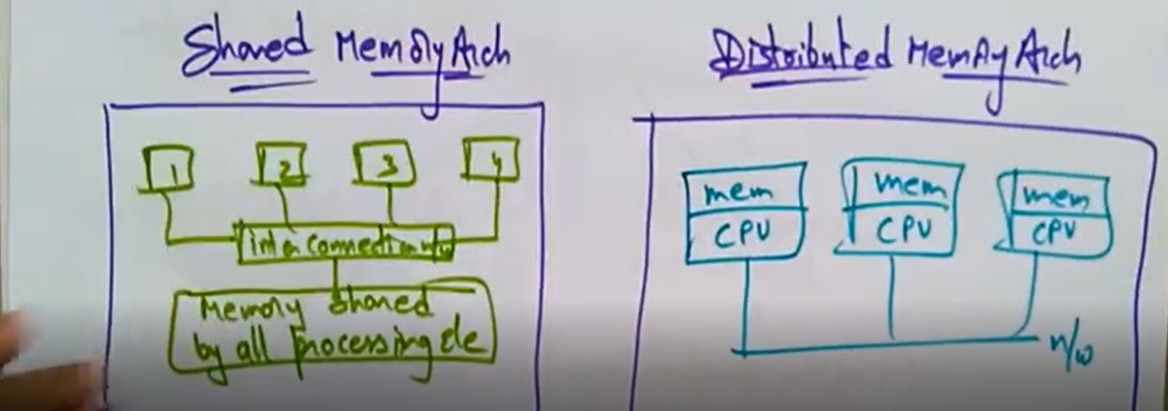

Slide 23
Distributed Computer Models
The D.S model is divided into two types
1- Fundamental models
2-Architectural models ( how is the system going to be established)
Fundamental models : they are based on some fundamental properties ( Characteristics , failure and security ) e.g. interaction model , failure model and security model .
Architectural models : These are based on architectural style e.g. Client server model and peer to peer model

Slide 24
Architectural Model
Arch. Model deals with the organisation of components across the network computers and their inter- relationship
client server model: it is the most important and mostly used D.S arch. It is based on the slave – master technology ( one computer as a client (slave ) and the other master (server).
The client and server roles are assigned and are changeable

Slide 25
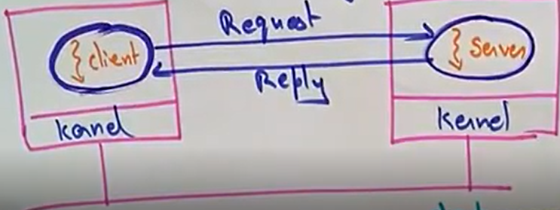
Client – Server
A kernel is an important component of OS capable of managing of the devices of the PC.

Slide 26
Time diagram of the client server
Wait for result
Client
Request
Reply
Provide the service

Slide 27
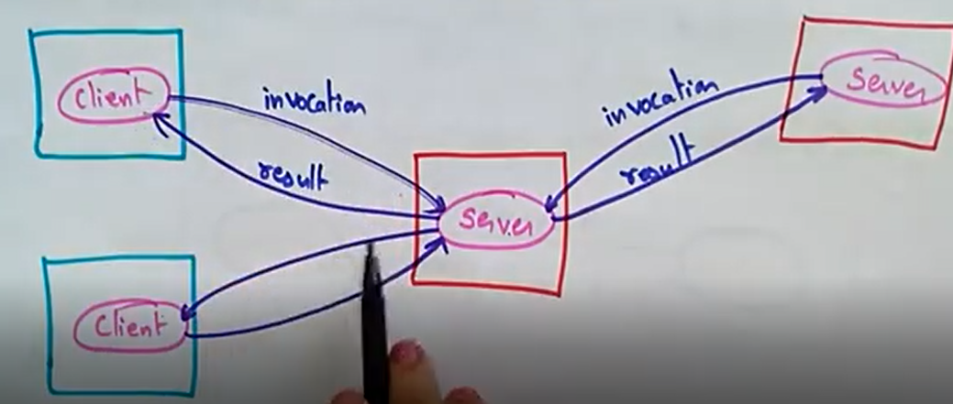
Client invocation of individual Servers

Slide 28
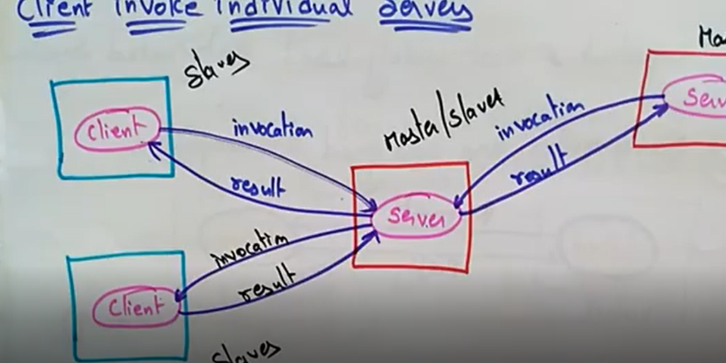

Slide 29
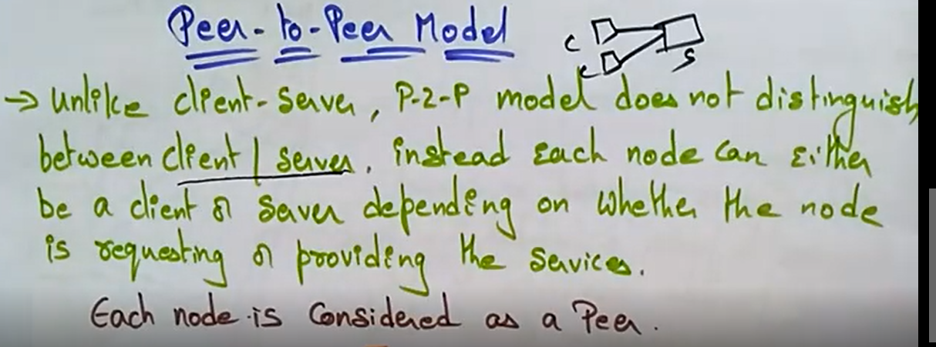

Slide 30
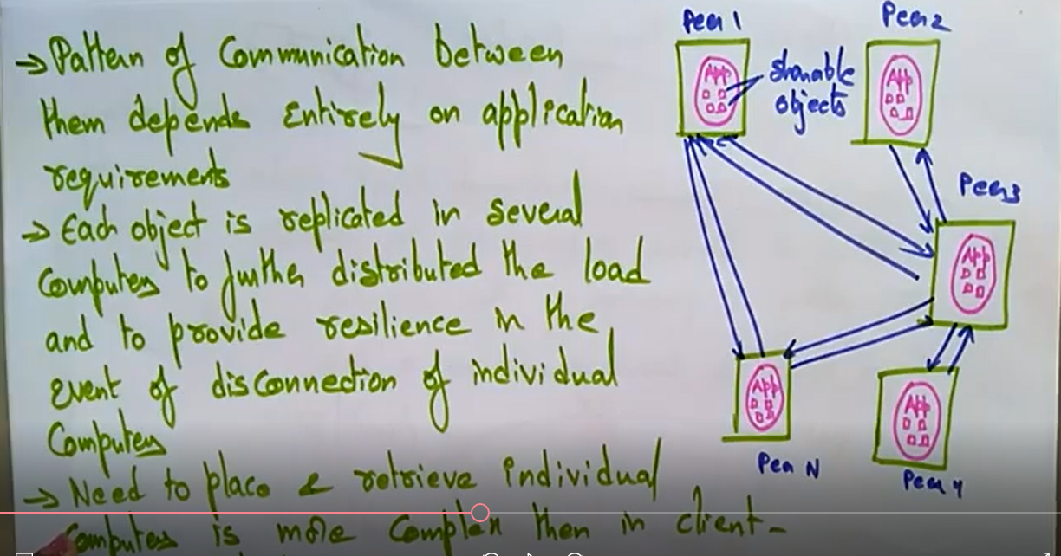

Slide 31
Fundamental Models
There 3 types of fundamental distributed models
Interaction Model (How would the sys be communicating ?)
It is based on fundamental properties such as :
-Characteristics
Failures
Security
Fundamentals properties of a sys

Slide 32
Cont……
In the interaction model , computation occurs within the processes.
The processes interact by messages resulting in :
Communication (information flow)
Coordination (synchronization and ordering of activities ) within processes.
The interaction model reflects the facts that communication takes place with delays

Slide 33
Performance of communication channels
It is based on the following :
Latency (which type of message, n/w or sys )
Bandwidth
Jitter
There are two variants of the Interaction Model
Synchronous
Asynchronous

Slide 34
Synchronous DS
It has :
-its process executing in a known lower and upper bounded time.
The message is received within a known bounded time.
Known local clocks drift rate .

Slide 35
Asynchronous DS
It has no bound on
Process execution speed
Message transmission delays
Clock drift rate

Slide 36
Failure Model
It defines and classifies the faults
What are the kind of failures that can occur in a sys?
1- fail Stop : A process halts and remains halted .Other processes can detect that the process has failed.
2- Crash : A process halts and remains halted . Other processes may no be able to detect the state.
3- Omission : A message inserted in an going buffer never arrives at the other ends incoming message buffer.

Slide 37
Arbitrary : The process or the channel exhibits arbitrary behaviour : it may send or transmit arbitrary messages at arbitrary times, commit omission; a process may stop or take incorrect step.
Timing failure: The clock drift exceeds allowable bounds.

Slide 38
Security Model
There several potential threats a sys designer need to be aware of:
Threats to processes: An attacker sends a request or response to a request with a false identity.
Threats to communication channels: an attacker may be listening to or save a message. (eavesdrop)
Denial of service: An attacker may overload the server by making excessive requests.
NB: Cryptography and authentication are often used to provide security.

